Slide 1
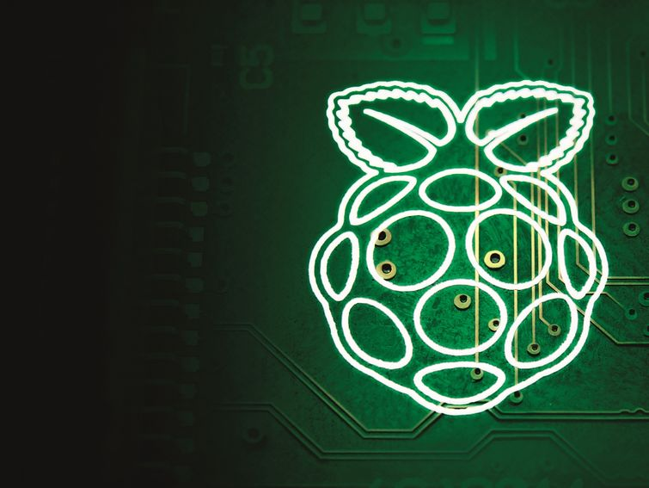

An Introductory Session on
Raspberry-Pi

Slide 2

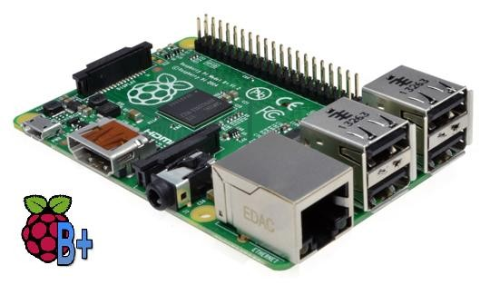
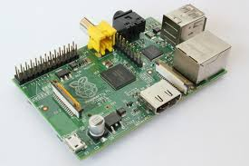
What is Raspberry Pi ?
Credit card size single board computer or a Programmable PC
Developed in U.K. by Raspberry - Pi foundation in 2009
Concept Initiated by Eben Upton who works at Broadcom
Supported by “University of Cambridge Computer Laboratory & Broadcom”
To promote the study of basic computer science in schools & to develop interest among kids and adults
Has been a revolution in the market with over 3 million units sold
Video Demo (www.raspberrypi.org)

Slide 3
Why Raspberry Pi ?
Very Low Cost ($25 – Rs 1550/- for Model A & $35 – Rs 2200/- for Model B/B+)
Great tool for Learning Programming, Computers & Concepts of Embedded Linux, etc
Support for all Age Groups (School Children, College Undergraduates, Professional Developers, Programmers)
Supports & runs Free and Open Source Linux OS
Consumes less than 5W of Power
Supports Full HD Video Output (1080p), Multiple USB Ports , etc
Fun to learn & explore. You are limited by your imagination

Slide 4
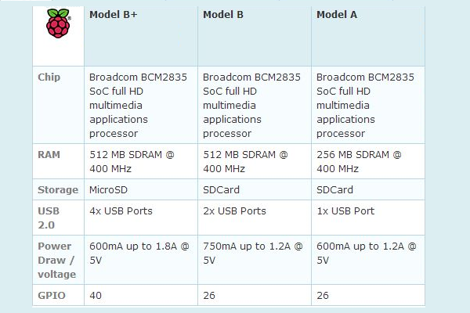
Raspberry Pi – Models
3 Main Models/Versions released till date with Model B+ being the latest in the series.

Slide 5
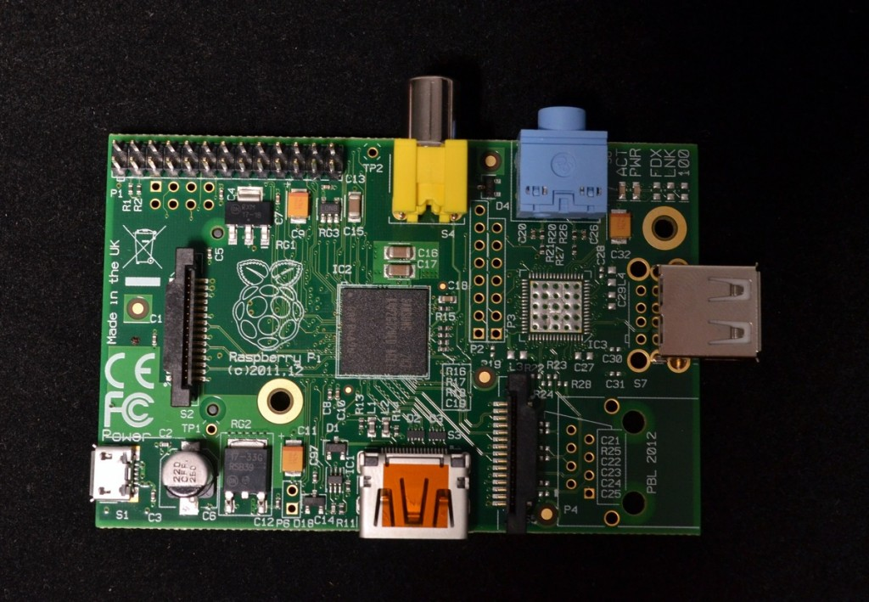
Raspberry Pi (Model A)

Slide 6
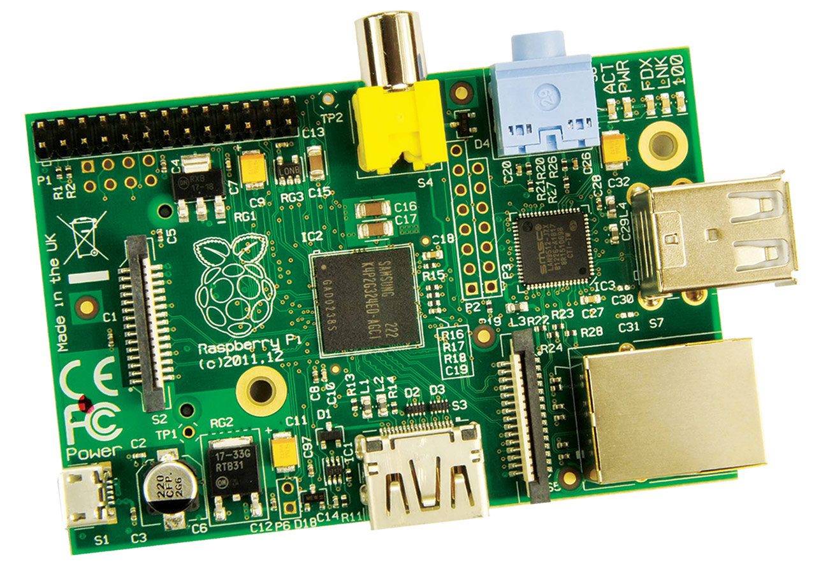
Raspberry Pi (Model B)

Slide 7
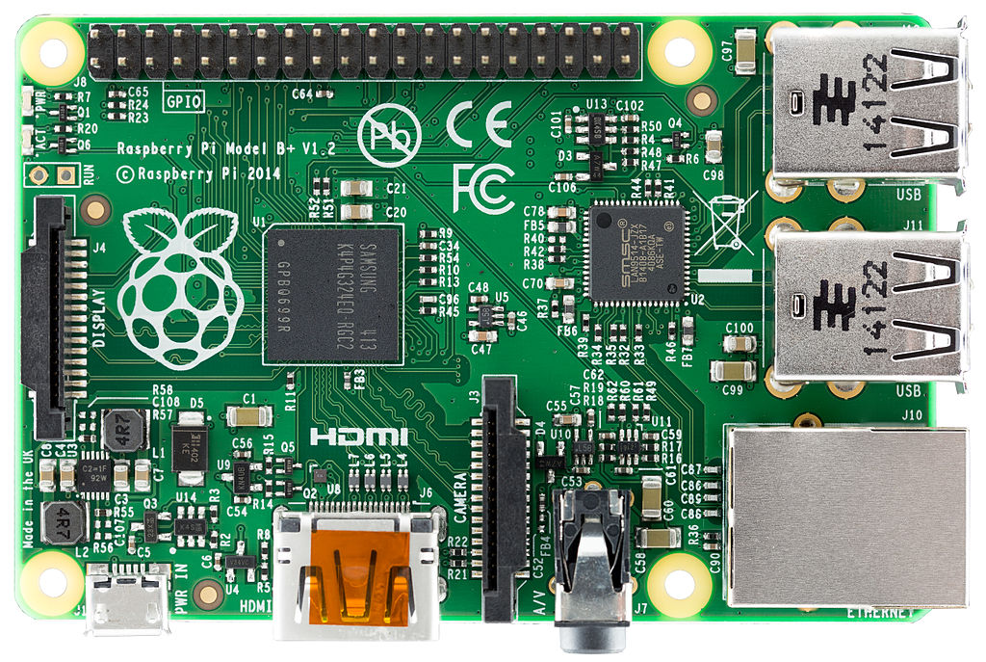
Raspberry Pi (Model B+)

Slide 8
Technical Specs.
Processor : Broadcom BCM2835 SoC (System on Chip)
Core : ARM11 (700 MHz ARM1176JZF-S)
Memory (RAM) : 256 Mb (Model A) or 512 Mb (Model B/B+)
GPU : Broadcom Videocore IV
USB 2.0 : 1 (Model A) / 2 (Model B) / 4 (Model B+)
On Board Storage : SD Card (Model A/B) / Micro SD (Model B+)
Video Input : Camera Support via CSI Connector
Video Output : Composite Video (RCA) or HDMI or LCD Support via DSI

Slide 9
Technical Specs. (Cont.)
Networking : 10/100 Mbit/s Ethernet Support on Model B/B+
Audio Outputs : 3.5 mm Jack
I.O. Lines : 26 Pin GPIO Connector on Model A/B and 40 Pin GPIO Connector on Model B+ (GPIO, UART, SPI, I2C, Power Rails, I2S, etc)
Power Source : 5V/2A DC Adapter via Micro USB
Power Ratings : 300 mA (1.5W – Model A), 700 mA (3.5W – Model B) & 600 mA (3W – Model B+)
Operating Systems : Raspbian, Debian, Pidora, Fedora, OpenELEC, ArchLinux ARM, FreeBSD,etc

Slide 10
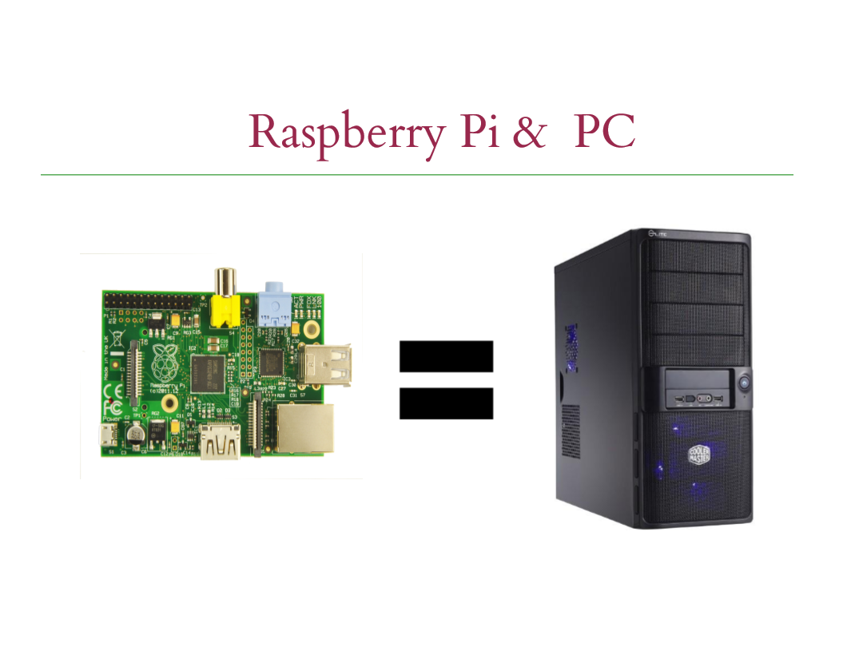
Raspberry Pi VS PC

Slide 11
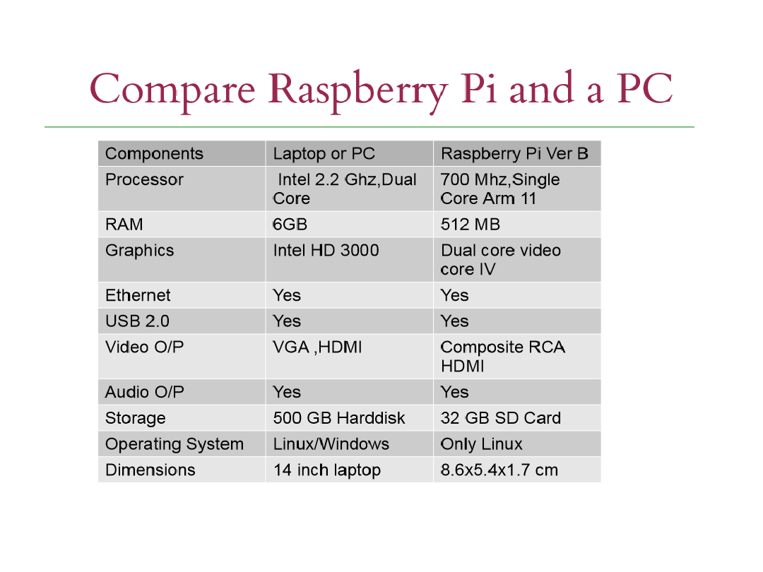
Raspberry Pi VS PC

Slide 12
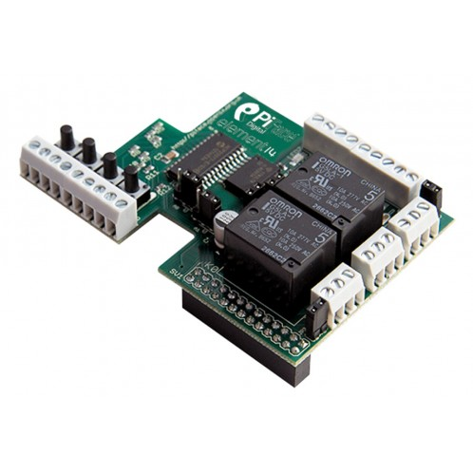
Raspberry Pi - Projects
1) Pi-Face : Hardware + Sensors + Electronics Interfacing.

Slide 13
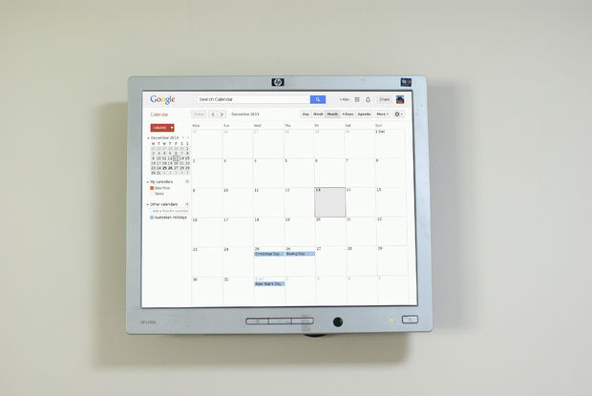
Raspberry Pi - Projects
2) Raspberry Pi Wall Mounted Google Calendar – On Instructables

Slide 14
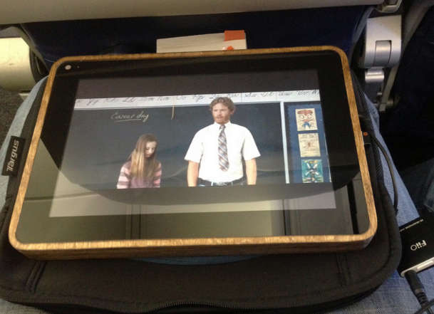
Raspberry Pi - Projects
3) PiPad: Tablet Using Raspberry Pi

Slide 15
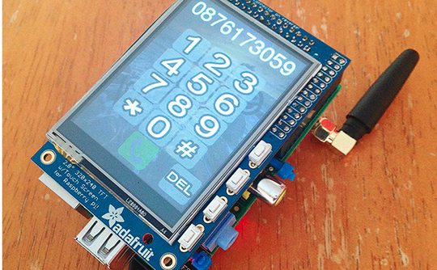
Raspberry Pi - Projects
4) PiPhone : Using Raspberry Pi

Slide 16
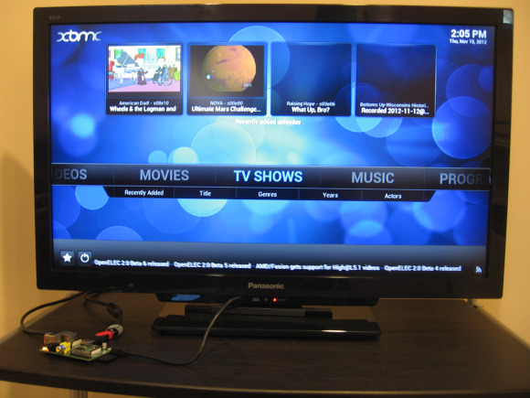
Raspberry Pi - Projects
5) Pi as a Media Centre : Using Open Source XBMC

Slide 17
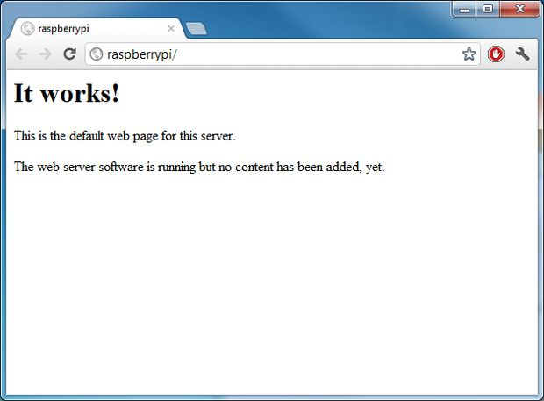
Raspberry Pi - Projects
6) Running a Web server on Raspberry Pi

Slide 18
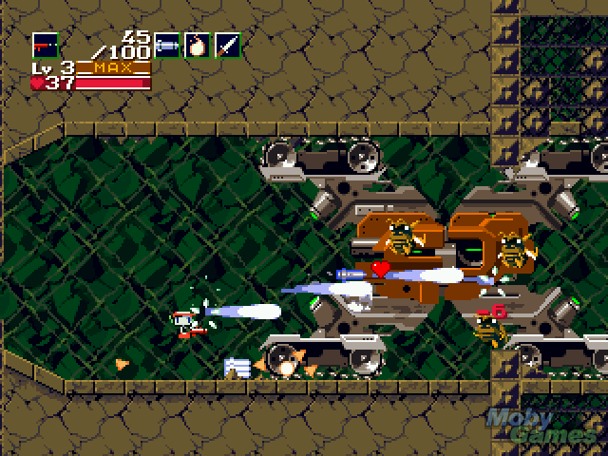
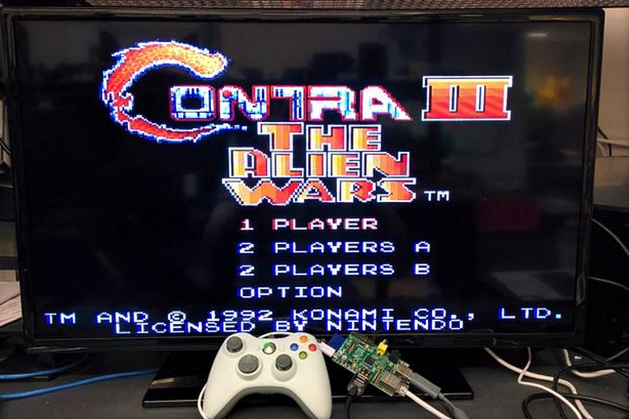
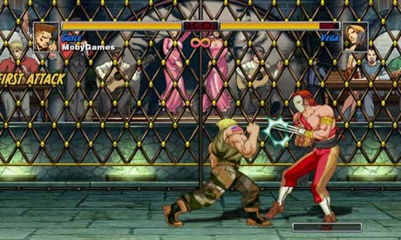
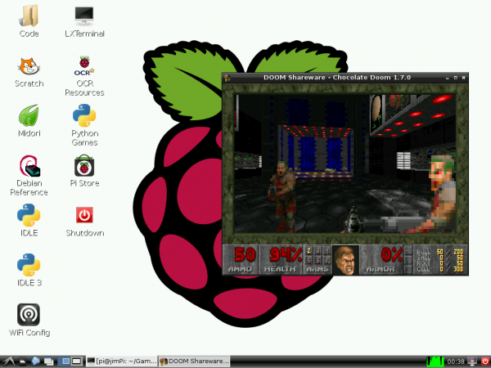
Raspberry Pi - Projects
7) Games on Raspberry Pi

Slide 19
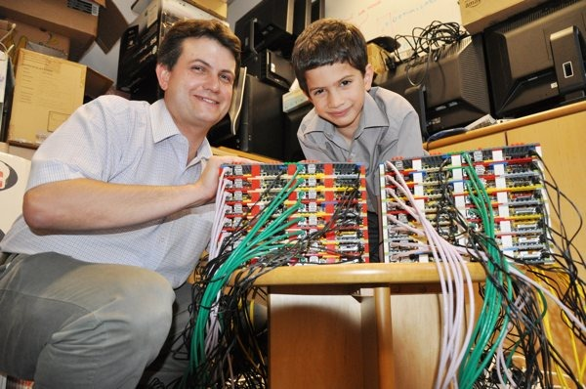
Raspberry Pi - Projects
8) Iridis-Pi : Supercomputer using Raspberry Pi (64 Processors, 1 TB of Memory

Slide 20
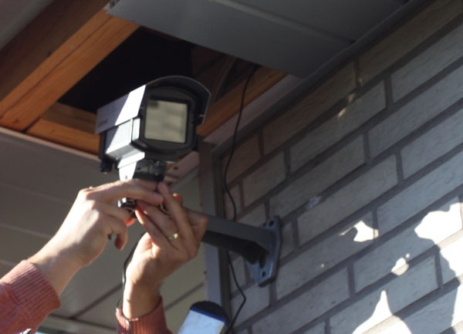
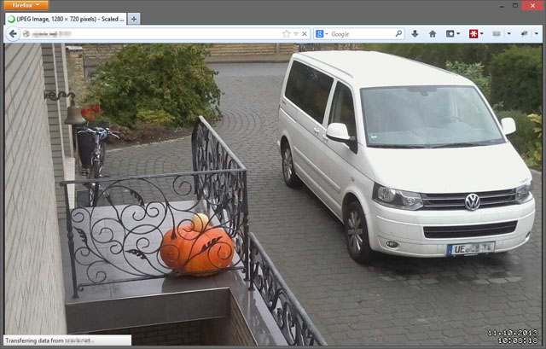
Raspberry Pi - Projects
9) Low Cost HD Surveillance Camera

Slide 21
Raspberry Pi - Setup
Raspberry Pi : Model A/B/B+ (recommended B+)
Power Source : 5V/2A DC Micro USB Adapter
Display : VGA Monitor/HDMI Screen or TV/LCD
SD Card : Minimum 4 GB (8GB - Class 4 recommended)
USB Mouse and Keyboard
Internet (If required) : Wi-Fi Dongle/ via Ethernet
Audio : 3.5 mm Stereo Input

Slide 22
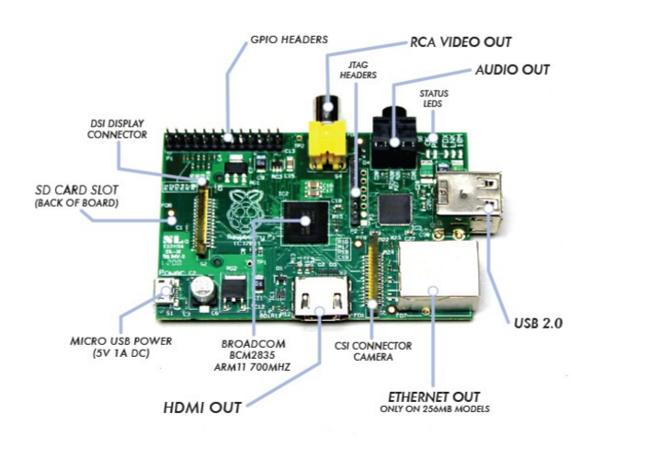
Raspberry Pi - Setup

Slide 23
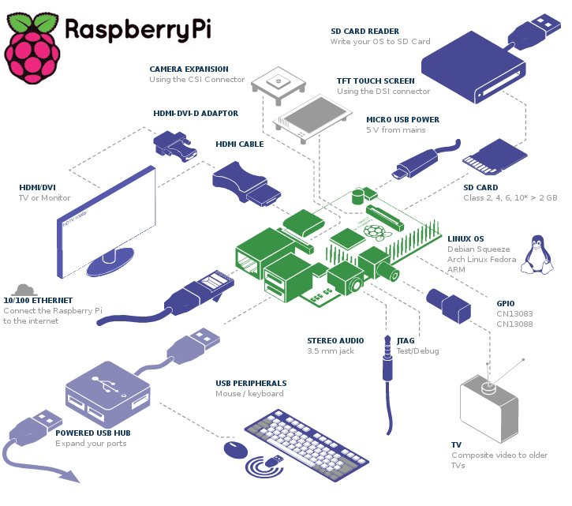
Lets Boot it up !

Slide 24
Handle with Care
The Raspberry Pi was built to be used, but not abused. Every P.C.B. should be handled with care.
Handle the Pi only by the edges of the board itself. Avoid touching or holding any of the components on the board.
Rough Handling can cause solder points to fail and may result in short circuits, but be careful with the GPIO pins as well.
While connecting Hardware, double check the connections and then power it up. Raspberry Pi GPIO’s are not 5V tolerant.

Slide 25
Preparing a SD Card
Format a SD card that is 4GB or larger as FAT.
Use the Tool – SDFormatter (How ?)
Download and extract the files from the NOOBS zip file.
Copy the extracted files onto the SD card that you just formatted so that this file is at the root directory of the SD card.
When this process has finished, safely remove the SD card and insert it into your Raspberry Pi and Power it up.
Raspberry Pi will boot, and a window will appear with a list of different operating systems that you can install. We recommend that you use Raspbian – tick the box next to Raspbian and click on Install.
Wait for it to finish. (15 – 20 mins)

Slide 26
First Boot Up
When the install process has completed, the Raspberry Pi configuration menu (raspi-config) will load.
Here you are able to set the time and date for your region and enable a Raspberry Pi camera board, or even create users.
To enter the Graphical environment enter the Command startx
Default Login ID : pi, Default Password : raspberry

Slide 27
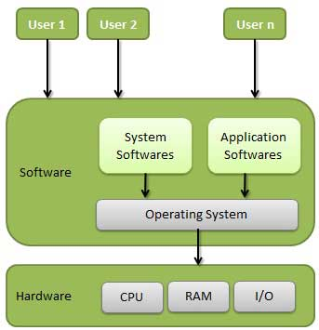
Operating System
A System Program that controls the execution of Application Programs and is an interface b/w Applications & Hardware.
It manages System Memory and Other resources of the system.
It makes computer convenient to use and allows system resources to be used in an efficient manner.

Slide 28
GNU/Linux
Raspbian is a free operating system based on Debian optimized for the Raspberry Pi hardware.
Debian is one of the most popular Linux Distribution or Flavour or Distro.
GNU/Linux – Free, Open Source, UNIX like Operating System that runs on diverse computing Hardware Platforms.
It has Ample Support for Software development, whether kernel or applications.
GNU : Provides the shell, library, compilers
Linux : Provides the Kernel
Examples of Major Free Distros : Fedora, Ubuntu, Mandriva, Suse, etc

Slide 29
Embedded Linux
Linux running on Embedded Systems.
Due to its low cost and ease of customization, Linux has been shipped in many consumer devices.
Even Android is a Linux Based Operating System which is the leading OS platform in Smartphone, Tablet Market.
Other examples include Set Top Boxes, Wireless Routers, smart TV’s, Industrial Automation, PDA’s, etc.
It has immense scope and endless opportunities .
The advantages of embedded Linux are multiple suppliers for software, development and support; no royalties or licensing fees; a stable kernel; the ability to read, modify and redistribute the source code.

Slide 30
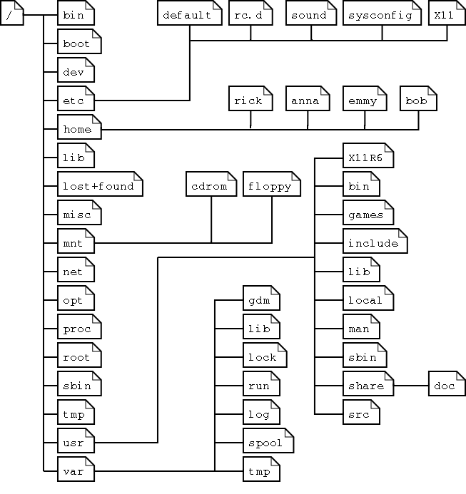
Linux File System
The arrangement of Files in Linux.

Slide 31
Directory Description
bin : Essential command binaries
boot : Static files of the boot loader
dev : Device files
etc : Host-specific system config
home : User login and data folders
lib : Essential shared libraries and kernel modules
mnt : Mount point for mounting a file system or media
opt : Add-on application software packages
proc : Virtual folder that has information about system

Slide 32
Directory Description
root : Home folder of the Linux super user
sbin : Essential system binaries
tmp : Temporary files
usr : Secondary hierarchy
var : Variable data

Slide 33
Linux Shell
To interact with the Operating System or Hardware we need to enter some commands in the “Shell”.
Simply put, the shell is a program that takes your commands from the keyboard and gives them to the operating system to perform.
In the old days, it was the only user interface available on a Unix computer.
Nowadays, we have graphical user interfaces (GUIs) in addition to command line interfaces (CLIs) such as the shell.
In GUI, we have "terminal emulators” or “consoles” which are programs that put a window up and let us interact with the shell.

Slide 34
Important Commands
1) ls
“ls” command displays the list of files present in a given directory.
2) cd
“cd” or change directory command allows the user to traverse through the directories and file paths.
3) cp
“cp” command is used to copy file(s) from a source to a destination.
4) mv
Move files from source to destination.

Slide 35
Important Commands
5) rm
“rm” command is used to remove file/files.
6) mkdir
“mkdir” command is used to make a new directory or folder in the current path.
7) rmdir
“rmdir” command is used to remove a directory or folder in the current path.
8) clear
“clear” command is used to clear the contents on the terminal window.

Slide 36
Important Commands
9) cat
“cat” command is used to concatenate and output the contents of the given files.
10) pwd
“pwd” command is used to check the present working directory.
11) sudo
“sudo” allows users to run programs with the security privileges of super user or root or administrator.
12) chmod
“chmod” allows users to change access modes on files.

Slide 37
Remote Login (ssh)
Secure Shell (ssh) is a network protocol which allows remote control of Raspberry Pi from another computer over the network.
Provides access to the Command Line and not to the Full Desktop Environment.
You can enable or disable the SSH server on your Raspberry Pi (it is enabled by default).
To Enable SSH, in the Terminal, enter sudo raspi-config, enable the ssh, finish and exit the menu.
Use a third-party SSH client software on your Windows System (like puTTy or TeraTerm) and access Raspberry Pi by entering it’s I.P. Address, user (pi) and password (raspberry).
To check Raspberry Pi’s I.P. Address, enter ifconfig in the terminal.

Slide 38
Desktop Sharing (VNC)
VNC (Virtual Network Computing) is a graphical desktop sharing system that allows you to remotely control the desktop interface of one computer from another.
It transmits the keyboard and mouse events from the controller, and receives updates to the screen over the network from the remote host.
This one is D.I.Y. and T.I.Y..
Links on the Text file with the steps.

Slide 39
Programming on R.Pi
Raspberry Pi supports several Programming Languages like : Python, C, C++, JAVA, Perl, HTML5, JavaScript, JQuery, etc.
Python is supported as the principal or main user programming language.
Extremely powerful and flexible language.
Can also be used to control hardware on the Pi.
Demo of Python Program on IDLE.
Demo of C Program on Raspberry Pi.
Compiled using gcc (GNU Compiler Collection)
Learning Programming = Practice Writing Programs

Slide 40
GPIO on Raspberry Pi
26 GPIO Header in Model A/B and 40 GPIO Header in Model B
These pins are a physical interface between the Pi and the outside world.
Out of 26, 8 are dedicated IO Lines, 2 are for UART, 4 are for SPI (+1 for Another Chip Select) , and another 2 for the I2C Interface (Total 17 out of 26)
Rest are Supply Rails.
Model B+ has 9 additional GPIO including a extra SPI (Total 17 + 9 = 26 out of 40)
WiringPi : Easy to use C Library for accessing the GPIO Lines via Programming (Arduino Style Programming)

